Slide 1


Slide 2
Making Resumés and Cover Letters Work for You
Jenny Soper, ILC Writing and Study Skills
Eleanor Miles, ILC Writing and Study Skills
Kay Ruth, ILC Writing and Study Skills

Slide 3
At the end of this session, you will know how to
Access resources at the college to support you in your job search, resumé creation, and cover letter writing,
Create your own resumé based on the three main components of a resumé,
Write a cover letter that effectively highlights your experience and education.

Slide 4
Wake Tech Career Services
https://www.waketech.edu/student-services/careers-employment
Career Coach
Build Your Resumé
Search for Jobs
Interview Preparation
Cover Letter Examples
Career Services Podcasts

Slide 5

What's the Difference?
Resumé
CV or Curriculum Vitae
Cover Letter
This Photo by Unknown author is licensed under CC BY.

Slide 6
What's the Difference?
Resumé- one page summary of your contact information, education, work experience, and skills
CV- a compilation of your contact information, education, work experience, additional professional activities like publications, conference presentations, and committees
Cover Letter-a letter describing your interest in the position and how the position fits your work background and/or relevant educational and life experiences
This Photo by Unknown author is licensed under CC BY.

Slide 7
What Will You Need?
Resumé
Cover Letter

Slide 8
What Can Happen Before the Resumé?
Procrastination leads to anxiety.
Anxiety leads to Writer's Block.
Writer’s Block wastes time!

Slide 9
How to Move Forward
To overcome procrastination, research first.
To fight anxiety about your qualification, analyze the job listing from your perspective.
To conquer writer's block, list by bullet points.

Slide 10
Research
Career Center webpage
Linked In
Networking

Slide 11

Start a Resumé Skeleton
This Photo by Unknown author is licensed under CC BY-SA-NC.
List your accomplishments.
Jot down what you know about the company.
Flesh it out.
Stay focused.

Slide 12
Analyze the Listing
Highlight
Highlight relevant information, like skills/action verbs, a mission statement or clues about the company culture
Match
Match your own skills and experience to the job-listing
Answer
Answer the question “Why do you want to work for us?”

Slide 13
Server/Dining Care Manager, Sunrise Senior Living
Job Position's Responsibilities:
How to Tweak It:
Serving as a role model in providing dining service to our residents
Assisting with training team members
Maintaining proper dining room set up
Assisting in special events
Monitoring appropriate checklists in support of the dining area's cleanliness, readiness, standards
Assisting in table-top inventories maintenance
Responsible for handling all food and beverages in accordance with sanitary procedures and standards
Ensure compliance with all federal, state and local regulatory procedures
Comparable experiences of being a model of kindness and care?
Serving others?
Any teamwork?
Party/Holiday Planning?
Helping with special event at volunteer organization or church?
Any work with inventory?
Planning, packing/transporting food for a family vacation or reunion/social/neighborhood event?

Slide 14
Server/ Dining Room Care Manager, Sunrise Senior Living
Job Posting's Qualifications:
How to Tweak it?
High School diploma preferred / GED accepted
Minimum of one (1) year experience in fine dining hospitality and/or full-service senior living
Ability to handle multiple priorities
Possess written and verbal skills for effective communication
Competent in organizational, time management skills
Demonstrates good judgment, problem solving and decision-making skills

Slide 15
Your Experience Matters
Many skills transfer from one environment to another, including unpaid to paid. Time management, problem solving, communication, and conflict resolution are needed everywhere. Identifying when and where you have used these skills and including them on your resumé will help you make the transition to a new career
Most of the time we are using more skills than we think we are.
We must identify them because if we don’t, the person reading the resumé surely won’t.

Slide 16

All Experience Counts
Volunteer at children's school or work on the PTA?
Involved with your HOA or a community group?
Work on projects with your church?
Organize activities for kids or adults?
Involved with sports activities in the neighborhood or community?
Help out at a family business or local organization?
Participate in food or clothes drives?
Help with web design or online webpage projects?
This Photo by Unknown author is licensed under CC BY-SA.

Slide 17
How to Match Your Experience to the Job You Want
Making sure you meet the job requirements = knowing the assignment.
Demonstrating that you know something about the organization and telling your story = the assignment sheet.
The resumé bullets = the supporting details.
The structure of each bullet = identifying steps in a process
Summary statement = thesis statement that the rest of the document supports.

Slide 18
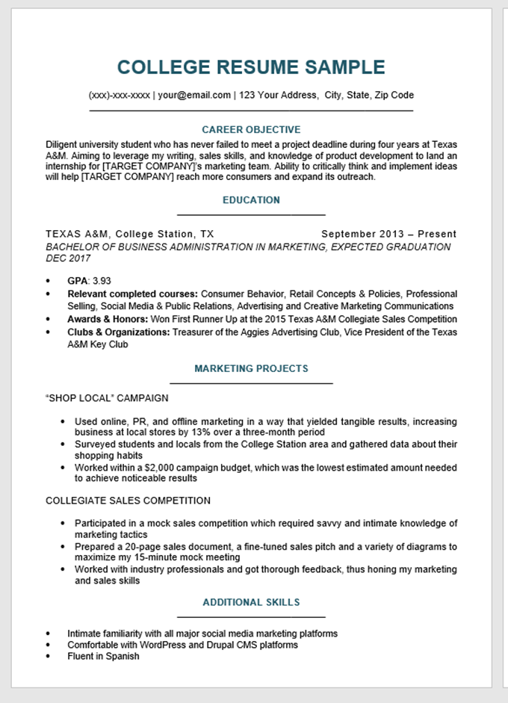



The Resumé
Your Contact Information: Name, Address, Phone Number, Email Address
This Photo by Unknown author is licensed under CC BY-SA.
Your Educational Background: College, High School
This Photo by Unknown author is licensed under CC BY-SA.
Your Experiences: Work and/or Other Activities
This Photo by Unknown author is licensed under CC BY-SA.
From: https://resumecompanion.com/resume-examples/college-student-resume-sample/

Slide 19
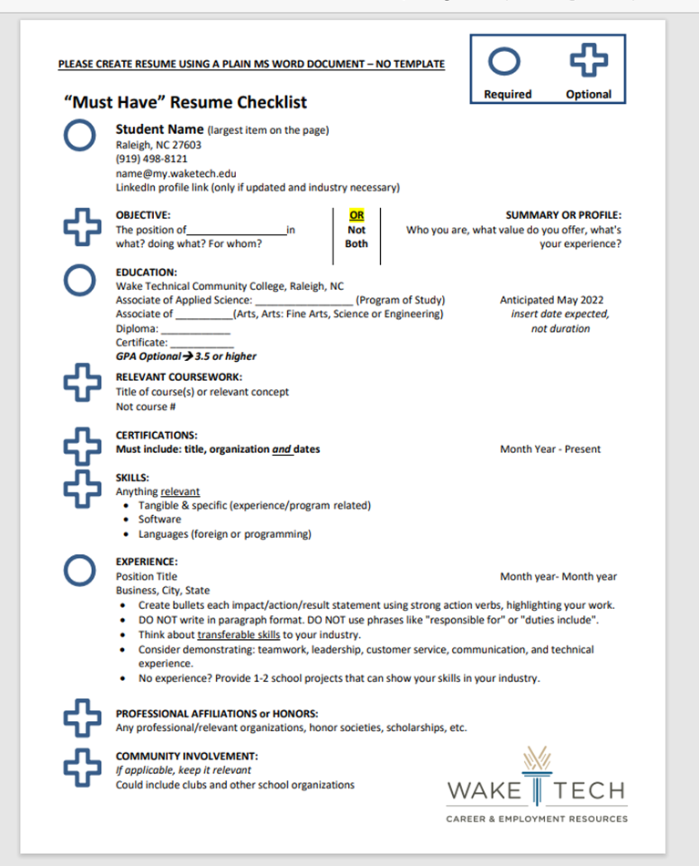
The Resumé
From: https://www.waketech.edu/sites/default/files/career_employment/Resume-Checklist.pdf

Slide 20
Words Matter
https://www.waketech.edu/sites/default/files/career_employment/action_verbs.pdf

Slide 21
Bullets Show Steps in a Process
From "Delivered food orders to customers"
To "Analyzed customer habits to identify the most lucrative opportunities and delivered restaurant meals to over 1500 satisfied customers, achieving a 4.9 rating"

Slide 22
Accomplishment Exercise
Make a list of 3-5 things you’ve done in your life that you feel good about, large or small, past or present. They do not all have to be work related.
Pick one from the list.
Look at the list of action verbs that we have given you and make some notes about which ones you used for the accomplishment. Often it helps to have a partner to talk it over with. Give as much detail as possible.
Repeat.
Look for patterns. Are some of the skills repeated across accomplishments? Is it important to have a job that requires those skills?

Slide 23
Ten Great Resumé Tips
A resumé gets you the interview, not the job.
The “best” information goes at the top. "Best” is defined as what it is about you that is the closest fit to the job. Put the Education section above Experience if you are in school.
A resumé is one page.
A resumé targets a specific job.
Resumés are not static. They change to match the job requirements.
Name the job in the objective or summary statement. Use the exact same words as in the job listing.
Account for your time. Use years and months, with no gaps, if possible.
An Experience section can include unpaid work. Employment means paid.
If you’ve done the same thing in more than one job, only say it once. Try to show an increase in responsibilities.
Don’t include tasks you don’t want to do in the next job.

Slide 24
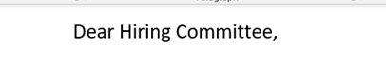
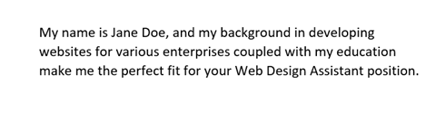
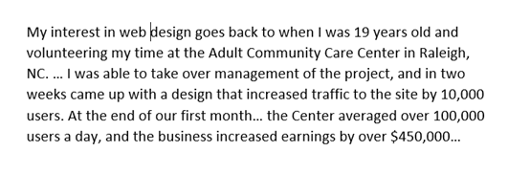
The Cover Letter
Matches resumé information but can go in more detail
Your name and contact information
What job you are interested in
Your educational, life, and work experiences that show you fit the job
https://www.waketech.edu/sites/default/files/page-file-uploads/Cover-Letter-Guide_DEC20.pdf

Slide 25

After the Resumé and Cover Letter
The Interview
Hopefully, “You’re hired.”

Slide 26
WTCC Resources
Career and Employment Resources
Resumé Checklist: https://www.waketech.edu/sites/default/files/career_employment/Resume-Checklist.pdf
Cover Letter Guide : https://www.waketech.edu/sites/default/files/page-file-uploads/Cover-Letter-Guide_DEC20.pdf
All Experience Counts: https://www.waketech.edu/sites/default/files/page-file-uploads/No%20Experience_Try%20This.docx.pdf
Individualized Learning Center: ilc.waketech.edu
Resumé writing support
Cover letter writing support
Action Verbs: https://www.waketech.edu/sites/default/files/career_employment/action_verbs.pdf
Researching and using your WTCC resources

Slide 27

Questions?

